Slide 1
Security design principles

Slide 2
Different types of threats
Defacement: It is a form of online vandalism in which attackers replace legitimate pages of an organization’s web site with illegitimate ones. In the years 1999 and 2001, for example, the White House web site was defaced by supposed anti-NATO activists (Dennis and Gold 1999) and Chinese hackers (Anderson 2001). In such defacement attacks, the attackers usually replace the front page of a web site with one of their own choice.
Infiltration: Infiltration is an attack in which an unauthorized party gains full access to the resources of a computer system. Consider the threat from an infiltration in which an attacker is able to write to a database running behind, say, a financial web site, but not be able to read its contents. If the attacker is able to write information to the database without reading it, the situation might not be as bad as you might think. So long as you can detect that the attacker’s write took place, the situation can be mitigated. You can always restore the correct account numbers and balances from a backup database, and redo all transactions that occurred after the unauthorized writes to prevent your users from being affected.

Slide 3
Phishing: It is an attack in which an attacker sets up a spoofed web site that looks similar to a legitimate web site. The attacker then attempts to lure victims to the spoofed web site and enter their login credentials, such as their usernames and passwords. In a phishing attack, attackers typically lure users to the spoofed web site by sending them e-mails suggesting that there is some problem with their account, and that the user should click a link within the e-mail to “verify” their account information. The link included in the e-mail, of course, is to the attacker’s web site, not the legitimate site. When unsuspecting users click the link, they arrive at the spoofed site and enter their login credentials. The site simply logs the credentials, and either reports an error to the user or redirects the user to the legitimate site (or both). The attacker later uses the logged credentials to log into the user’s account and transfer money from the user’s account to their own.
Insider threats: A surprisingly large percentage of attacks take place with the cooperation of insiders. Insiders could be, for instance, employees at a corporation who abuse their privileges to carry out malicious deeds. Employees are sometimes trusted with access to databases with customer information and employee records, copies of financial reports, or confidential information concerning product launches. Such information can be abused in the obvious ways: employee data could be sold to headhunters, customer credit card numbers could be sold on the black market, financial reports could facilitate insider trading, and product launches could be leaked to the press.

Slide 4
Pharming: It is another attack in which a user can be fooled into entering sensitive data into a spoofed web site. It is different than phishing in that the attacker does not have to rely on the user clicking a link in an e-mail. With pharming, even if the user correctly enters a URL (uniform resource locator)—or web address—into a browser’s address bar, the attacker can still redirect the user to a malicious web site. When a user enters a URL—say, www.google.com/index.html—the browser needs to first figure out the IP address of the machine to which to connect. It extracts the domain name, www.google.com, from the URL, and sends the domain name to a domain name server (DNS). The DNS is responsible for translating the domain name to an IP address. The browser then connects to the IP address returned by the DNS and issues an HTTP request for index.html. In a pharming attack, an attacker interferes with the machine name–to–IP address translation for which the DNS is responsible. The attacker can do so by, for instance, compromising the DNS server, and coaxing it into returning the attacker’s IP address instead of the legitimate one. If the user is browsing via HTTP, the attack can be unnoticeable to the user. However, if a user connects to a site using SSL, a pharming attack (in most cases) will result in a dialog box from the browser complaining that it was not able to authenticate the server due to a “certificate mismatch.”

Slide 5
Click fraud: Pay-per click advertising is an Internet advertising model in which advertisers provide advertisements to search engines. Search engines work with web site publishers to insert advertisements not only on search result pages, but also on publisher’s content pages. The idea is that the entire page of content on a publisher’s site is considered a “query” for the search engine, and relevant ads are inserted on the publisher’s web page. Advertisers pay the search engine whenever users click on those advertisements. Web site publishers typically receive a revenue share for clicks on ads that occur on their site. Advertisers usually set a maximum daily budget for their advertising campaigns so that their advertising costs do not go unbounded.
Such a pay-per-click advertising system can be abused in several ways. We will describe two of them. In one type of click fraud, an advertiser will click a competitor’s ad with the intention of “maxing out” their competitor’s budget. Once their competitor’s budget has been exhausted, their ads may exclusively be shown to legitimate users. Such an attack ends up wasting the competitor’s financial resources, and allows the attacker to receive all the legitimate ad clicks that their competitor might have received. In another type of click fraud, a web site publisher will click on ads shown on their own web site in an attempt to receive the revenue share for those clicks. In some cases, the fraudulent publisher can hire a third-party firm or deploy malware to click on the ads.

Slide 6
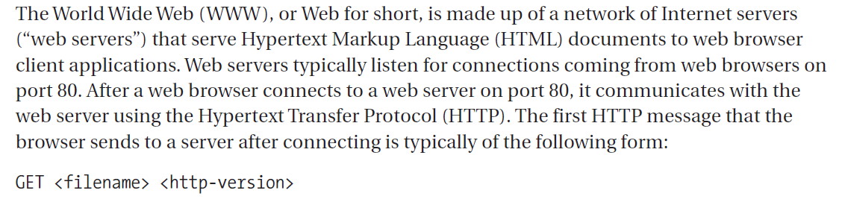
Denial-of-service (DOS): Another significant threat that e-commerce and financial institutions face are DoS attacks. In one type of DoS attack, the attacker sends so many packets to a web site that it cannot service the legitimate users that are trying access it. A financial institution or e-commerce site can end up losing money and revenue as the result of such a DoS attack because its customers will not be able to conduct transactions or make online purchases.
How does Hypertext Transfer Protocol work?

Slide 7
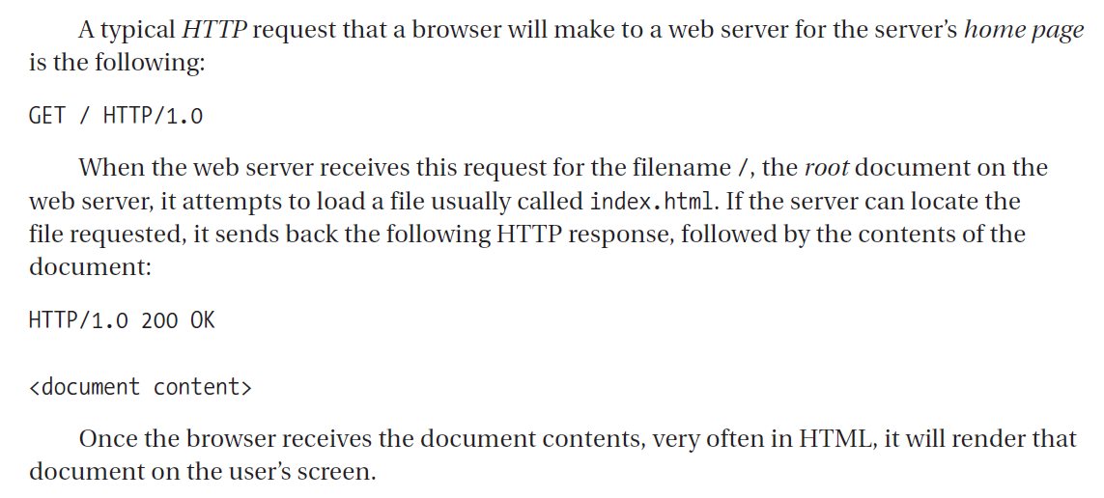

Slide 8
Design principles
The principle of least privilege
The principle of least privilege states that a user or computer program should be given the least amount of privileges necessary to accomplish a task. A common example in which the principle of least privilege works in the physical world is the use of valet keys.
When you design and use software, you should attempt to employ the same kind of mentality with respect to giving programs just enough permissions for the job that they are required to accomplish. If you are designing or implementing a web server that is only responsible for serving static (read-only) marketing pages to web users, the web server should only be given access to the exact set of files that the web server serves to its clients. The web server should not be given privileges to access the company employee database or any other resource that would allow it to do more than serve the marketing pages. By following this approach, if anyone breaks into the web server, the hope is that the most that the attacker will be able to do is read the files that make up the marketing pages, because that is all the web server is able to do. If the web server is configured correctly and not given write access to the files, then you would also expect that the attacker would not be able to deface the web site.

Slide 9
Defense in depth
Defense-in-depth, also referred to as redundancy, is the second design principle.
Prevent, detect, contain and recover: The point of defense-in-depth is to not rely on any one defense to achieve security. Multiple mechanisms can help you achieve more security than just one. Some mechanisms might help prevent attacks. in the world of network security, it may not even be clear when an attack is taking place. As such, some mechanisms might help you detect when attacks are taking place. Since it is not always possible to prevent attacks altogether, it is important to deploy mechanisms that help you manage or contain attacks while they are in progress. After an attack takes place, you want to be able to recover from the attack, to whatever extent possible.
Don’t forget containment and recovery: Preventive techniques may not be perfect, and may fail. On the Internet, malicious traffic needs to be treated. It may take some time to identify and/or detect malicious traffic before the connections with malicious sources can be dropped. In the interim, you need to contain damage that can impact the normal operation of the network. In a distributed system, it is also important that once malicious parties have breached the preventive mechanisms, and while the existence, locations, and identities of the malicious actors are in the process of being detected, attack containment techniques be used to minimize the impact of the attack while detection and recovery procedures are executing.

Slide 10
iii) Password security: To consider an example from the world of password security, system administrators can attempt to prevent password-guessing attacks against their web site by requiring users to choose strong passwords. To help detect password-guessing attacks, web
server logs can be monitored for a large number of failed logins coming from one or more IP
addresses, and mark those IP addresses as suspicious. It is still likely that the attacker may stumble upon a significant number of valid username and password combinations, and it is important to reduce the number of accounts that get compromised during an attack. One option might be to deny all logins from the suspicious IP addresses to contain the attack, or require an additional check to see if the client presents the web server with a cookie that was provided upon last successful login. Still, the attacker may obtain a few valid usernames and passwords, especially if the attacker has access to many IP addresses—but the goal of containment is to lower the impact
of the attack, not prevent it entirely. Finally, to recover from the attack, you could monitor
account activity for the usernames for which there were successful logins from the suspicious
IP addresses, and deny any transactions that look suspicious, such as monetary transfers to
addresses outside the country. The web site may also have to file an insurance claim to financially
recover from any successful fraud that the attacker was able to conduct, and purchase
credit monitoring services for customers whose accounts were compromised.

Slide 11
Diversity in defense
Diversity-in-defense is about using multiple heterogeneous systems that do the same thing. One example of using diversity-in-defense is the use of multiple operating systems within a corporation to mitigate the impact of viruses. For example, one could back up data (say, e-mail) on machines that use different operating systems. If a virus attacks Microsoft Outlook, which only works on Windows platforms, it will be able to corrupt all the computers in a corporation that are running Microsoft Windows. However, it is unlikely that the same virus will be able to attack redundant copies of information stored on machines running a different operating system, such as Linux. Using a variety of operating systems protects the entire corporation against attacks on a particular operating system. Diversity-in-defense does come at a cost, though. By using more than one OS, the IT staff may come under the burden of having to be experts with more than one technology, and will also have to monitor and apply software patches to multiple technologies. The IT staff must keep such trade-offs in mind and weigh the extra security that diversity-in-defense might
provide against the extra complexity and effort it requires.

Slide 12
Securing the weakest link
The weakest link is the part of a system that is the most vulnerable, susceptible, or easiest to attack. Weak links can be
Weak passwords
People
Implementation vulnerabilities: Even a correctly designed piece of software typically has lots of bugs in the implementation of that design. Some of those bugs are likely to lead to exploitable security vulnerabilities. Even though an application might use encryption to protect data, it is often possible for an attacker to get access to the protected data not by attacking the encryption function or cracking the encryption key, but by finding bugs in how the software uses (or rather misuses) the encryption function. Another common example of implementation vulnerability involves the inadvertent mixing of control and data. Attackers can send input data to a program that gets interpreted as a command, which allows them to take control of the program.

Slide 13
Fail-Safe Stance
Fail-safe stance involves designing a system in such a way that even if one or more components
fail, you can still ensure some level of security. For example, a firewall is designed to keep malicious traffic out. If a firewall ever fails, it should deny access by default and not let any traffic in. This will be inconvenient for users, but at least the information system protected by the firewall will not be insecure. If, on the other hand, the firewall fails and decides to let all traffic through, attackers could figure out how to induce the firewall to fail, and then would be able to send malicious traffic in. If the firewall is instead designed to let no traffic in upon failure, attackers would not have any additional incentive (besides that of conducting a DoS attack) to try to get the firewall to fail.
Secure by default
When you design a system, it should, by default, be optimized for security wherever possible. One problem that some software vendors have had in the past is that when they deploy their software, they turn on every possible feature, and make every service available to the user by default. From a security standpoint, the more features that are built into a piece of software, the more susceptible it is going to be to an attack. An operating system, for instance, can contain a lot of features and functionality when it is shipped by the OS vendor, but the amount of functionality available should be reduced. The reduction involves turning off all unnecessary services by default.

Slide 14
Software vendors have recently started taking the concept of secure defaults much more seriously. For example, the Microsoft Windows operating system was originally deployed with all of its features on in the initial configuration. Microsoft configured various functionality offered by their operating system such that it was enabled by default. However, having Internet Information Sever (IIS), Microsoft’s web server, on by default made millions of Microsoft Windows computers easier to attack by malicious parties. Worms such as Code Red and Nimda used exploits in IIS to infect the computer on which it was running, and used it as a launching pad to infect other machines. Because other computers running Windows had IIS turned on by default, the worm was able to spread and infect the other computers quickly.
In newer versions of Windows, Microsoft has turned IIS, as well as many other features in the operating system, off by default. This drastically reduces the ability of a worm to spread over the network. Hardening the initial configuration of Windows is one example of how keeping features off by default helps reduce the security threat posed by worms.
Usability
Usability is also an important design goal. For a software product to be usable, its users, with high probability, should be able to accomplish tasks that the software is meant to assist them in carrying out. The way to achieve usable software is not to build a software product first, and then bring in an interaction designer or usability engineer to recommend tweaks to the user interface.

Slide 15
Simplicity
Keeping software as simple as possible is another way to preserve software security. Complex software is likely to have many more bugs and security holes than simple software. Code should be written so that it is possible to test each function in isolation. One example of a large, complicated piece of software that has had many security holes is the UNIX sendmail program (www.sendmail.org). A simpler design and fewer lines of code can mean less complexity, better understandability, and better auditability.
In order to keep software simple and security checks localized, you can take advantage of a concept called a choke point. A choke point is a centralized piece of code through which control must pass. You could, for instance, force all security operations in a piece of software to go through one piece of code. For example, you should only have one checkPassword() function in your system—all password checks should be centralized, and the code that does the password check should be as small and simple as possible so that it can be easily reviewed for correctness. The advantage is that the system is more likely to be secure as long as the code is correct. This is all built on the concept that the less functionality one has to look at in a given application, the less security exposure and vulnerability that piece of software will have. Software that is simple will be easier to test and keep secure.

Slide 16
Thank you
Dr. Rachaita Dutta
Assistant professor
Dept. of mca
  9007223301
  rachaitadutta@my.amrita.edu

